Slide 1
Impact of recent economic trends on pubs and breweries
A report produced for the BBPA
March 2025

Slide 2
Contents
Topic
Summary
Supporting detail: Economic environment facing pubs & brewers
Annex 1: Landscape of pubs and brewers in the UK
Annex 2: Economic model of pubs and brewers
Annex 3: Current economic impact on pubs and brewers
Annex 4: Methodology and interview findings

Slide 3
About this report
Frontier Economics were commissioned by The British Beer and Pub Association (BBPA) in Autumn 2022 to analyse the pub and brewery sector, the pressures faced post-Covid, and why the sector is particularly distinctive in the need for support.
Given the rapidly changing economic environment and pressures faced by the sector, this report provides an update to the economic environment facing pubs and brewers as of early 2025.
This report builds on the previous update from August 2023, focusing on how costs and demand have changed over the past year and what is expected to happen over the next year.
This report does not re-examine the overall landscape and economic model of pubs and brewers which will not have changed. This part of the analysis has been moved to Annex 1 and 2.

Slide 4
Acute shocks have eased but pressures remain, with further impact of rising labour costs, business rates, and new regulations – and differential impacts across firms
01
02
03
Some economic pressures have eased – but high costs remain structurally embedded
Further cost pressures incoming, driven by policy interventions
Businesses seek growth but investment is constrained
While inflation has eased and some costs have started to fall, overall expenses—such as energy, wages, and supply chain costs remain high vs historic levels (and many of these costs remain volatile).
Competitive, slim margin sector so higher costs have largely been passed through to customers via higher prices.
Consumer confidence has slightly improved from record lows in 2023 but remains fragile, and spending is still cautious, despite slight improvements from recent lows.
Multiple policy changes will hit sector costs in 2025 – NLW, NMW and NICs increases, EPR / PRN changes, reduction in Business Rates Relief, and changes to Business Property Relief.
Businesses are having to navigate both the cumulative cost impact of these and the uncertainty of some (EPR in particular).
Any reductions in energy or raw materials are offset by these new pressures.
There is concern that further price hikes, particularly in pubs, will push customers away, impacting volumes and margins.
Pubs and brewers continue to innovate and adapt, but further investment is needed to unlock long-term growth.
While some businesses actively invest in expansion and innovation, uncertainty around costs, demand, and regulation holds others back.
Larger businesses better positioned to capitalise on opportunities, while smaller and mid-sized businesses are potentially more exposed to burden of new regulation and cost pressures.
Investment and operational decisions are made at the pub level so as well as independents, some managed community pubs – despite part of larger groups – remain exposed.

Slide 5
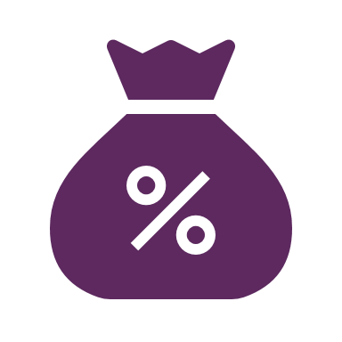
Pubs and brewers face a range of demand and cost pressures over the next year – In addition to structurally higher costs
DEMAND AND COST PRESSURES OVER THE NEXT YEAR
STRUCTURALLY HIGHER COSTS
PACKAGING POLICIES
Change in rules for Packaging Recovery Notes (PRNs) will shift full cost burden on to brewers (away from retailers).
Regulatory burdens and uncertainty from newly introduced Extended Producer Responsibility (EPR) – estimated 5p - 7p a bottle
Expected introduction of Deposit Return Scheme (DRS) on the horizon (sector costs estimated at £100m over 2 years)
CONSUMER DEMAND
Spending power remains fragile, squeezed by sustained high costs – hits volumes
42% of consumers said they are going out less frequently than a year ago (January 2025) – hit to on-trade
COMMODITIES
Coming down off peaks but will remain ~25-30% higher than 2019
ENERGY
Despite costs coming down, the sector still faces 1.5-2.5x higher energy prices
BUSINESS RATES
Reduction in business rate relief from 75% to 40%, will come in to effect from April 2025
This is a £5.5k increase for the average pub’s business rates bill
FOOD AND DRINK
Up to 20% higher food Cost-of-goods-sold (COGS) persist as raw material & energy prices increase supplier costs
WAGES
National Living Wage (NLW) to rise by 7% in April 2025
National Minimum Wage (NMW) to rise by 16% and 18% for 18-20 year olds and 16-17 year olds respectively
Direct impact on lowest paid, and further impact on pay rates above to maintain some differentials
NICs
Threshold for employer National Insurance Contributions (NICs) down from £9,100 to £5,000
Rate of employer NICs increased from 13.8% to 15%
INTEREST RATES
Rates at their highest point in 15 years – slower pace of rate cuts anticipated vs last year

Slide 6
Regulatory burdens and uncertainty is creating additional challenges for the sector – potentially holding back investment
The sector is facing multiple regulatory pressures that add to existing financial challenges – three of the top four concerns of the sector relate to government economic policy (CGA Survey, Jan 2025).
The biggest concerns are the immediate costs associated with increases to NICs, NLW, NMW, EPR, Business Rates and Business Property Relief (BPR). Each bringing financial strain for the sector to navigate.
Beyond direct costs, some regulations add heavy administrative burdens, particularly EPR and new workplace rules. Even well-intentioned policies can create inefficiencies if not carefully designed. For example:
EPR could lead to double charging – Nearly all packaging classified as ‘household’ waste never leaves a venue and is disposed of commercially – with recycling rates already high, meaning businesses could face both EPR charges and commercial waste fees.
Energy Performance Certificate (EPC) requirements force investment in building efficiency, often with lower returns than investing in more energy-efficient equipment. Particularly as pubs are often listed or older buildings which complicates these investments
Uncertainty around future policy is also a key concern. For instance, DRS could require major operational changes which brewers estimate will cost them ~£100m over the next 2 years. Or an increased focus on reuse which would require significant investment in packaging lines and washing facilities. Further uncertainty from the Guest Beer investigation.
Moreover, EPR implementation remains particularly uncertain – although the costs will begin to be levied from April, businesses won’t receive the bill until October, complicating financial planning.
The cumulative impact of multiple pressures arriving at once – often with practical implications for businesses – makes it particularly challenging for the sector to navigate.
Labour costs
(NICs, NLW, NMW, Workplace rules)
Net Zero
(EPC requirements)
Packaging
(PRNs, EPR, DRS, focus on reuse)
Duty
(Off-trade increases)
Business rates
(reduced relief, rate changes)
Wider policy
(BPR, Guest Beer investigation)

Slide 7
Well-designed and communicated regulation for pubs and brewers can support stability and growth in this important & vibrant sector
Pubs play an outsized role in communities across the UK – and depend on brewers
Pubs are particularly exposed to combination of cost and demand shocks
New regulation presents greater challenges for smaller businesses
A predictable regulatory environment promotes long-term stability and growth
A healthy pub sector helps brewers, which rely on the on-trade
Individually small businesses but collectively a big source of jobs (1m jobs supported)
Present in every part of the UK, which means benefits are widespread
Goes beyond economic impact of jobs, to include role as social hub bringing people together
Brewers provide a key input to successful pubs
Pubs face c.38% combined cost increases since 2019 despite inflation slowing – food, drink, energy, labour, packaging all cost more
Costs unavoidable: energy-intensive and people-focused service & hospitality businesses
Most cost increases have been passed onto consumers, but cost-of-living crisis threatens discretionary spending – which exposes spend at pubs, and a knock-on effect to brewers
Larger pubcos & brewers more exposed to cost increases (larger labour force). But many have resources to fall back on
Whereas SME pubs – including independents and L&T (78% of all pubs) & brewers (~1.8k) are less able to absorb rising costs
High administrative burdens and investment costs to deal with complex regulations (e.g. EPR, workplace rules, EPC) disproportionately impact smaller operators
A structured implementation timeline helps businesses plan for regulatory changes and manage associated costs
Effective regulation balances policy objectives with business feasibility, ensuring clarity and minimising complexity
Business rate reform can be a key lever for growth and stability – if done with real impact
Many brewers are looking to invest in modernising their breweries.
Depend on a healthy on-trade to do so – important source of sales and profit.
Small and medium sized brewers rely even more heavily on the on-trade – 95% of sales to on-trade
Pubs, in turn, benefit from a diverse brewing sector offering variety and innovation

Slide 8
Sector investment reflects the impact of government intervention and business outlook, with some cutting back while others continue to invest and expand
Businesses see the importance of investment to strengthen their position in the sector. Without investment, they risk being left behind by changing market dynamics.
Larger, well capitalised companies are better positioned to continue investing. For example, many breweries are focusing on modernising to reduce energy consumption or looking to take advantage of growth areas – e.g. no and low-alcohol. And many pubs are investing to refresh fitout to make their pub more appealing / attractive to customers
However, investment and sector growth are being held back by rising costs or policy uncertainty – even in some of these growth areas. 60% of businesses reported cancelling investment due to the recent budget (CGA Survey, Jan 2025).
This is particularly true for smaller businesses (especially pubs) who face challenges even maintaining current investment levels due to additional cost burdens. Signs that some leased and tenanted pubs are less willing to commit to longer term contracts due to the uncertainty – which inevitably reduces the amount invested.
Well-designed regulation gives businesses the confidence to invest – helping the sector grow:
Effective regulation balances policy objectives with business feasibility, ensuring clarity and minimising complexity and administrative burdens.
A coordinated approach to regulation helps businesses navigate multiple policy changes more effectively. While individual regulations may be manageable, their combined effect can create additional complexity for the sector.
Providing businesses with sufficient lead time to adapt to regulatory changes can support investment, innovation and long-term planning.
Expansion of new market segments (e.g. no and low-alcohol)
Smart supply chain and logistics
Investment opportunities
Diversification of revenue streams
Brewery modernisation
Energy efficiency equipment
Venue upgrades & experience enhancement
Higher operating costs / pressure on cash flows
Uncertainty in government policy
Investment constraints
Shifting consumer behaviour
Few incentives to commit long term
Regulatory overload
Administrative burdens of regulation
Financing challenges (higher interest rates)

Slide 9
Contents
Topic
Summary
Supporting detail: Economic environment facing pubs & brewers
Annex 1: Landscape of pubs and brewers in the UK
Annex 2: Economic model of pubs and brewers
Annex 3: Current economic impact on pubs and brewers
Annex 4: Methodology and interview findings

Slide 10
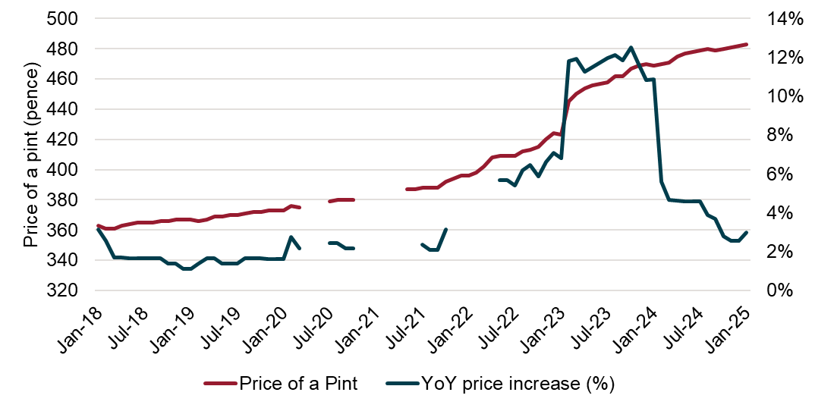
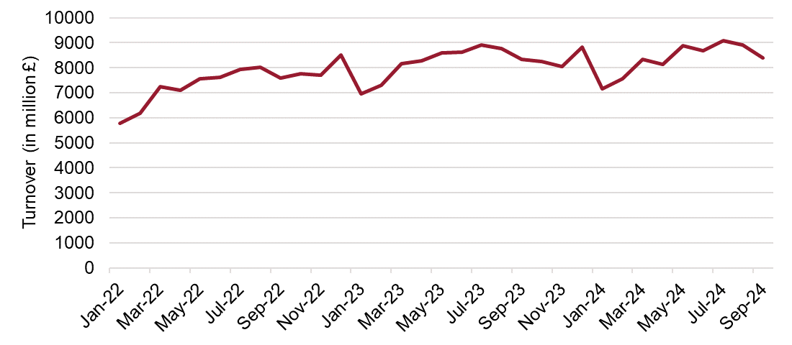
The sector is now operating with higher costs which have largely been passed through as higher prices
Since 2019, successive economic shocks have increased costs for brewers and pubs. While inflation has now eased, these costs have stabilised at a much higher level.
Rising costs across energy, raw materials, labour, and logistics have reshaped the sector’s cost base.
While inflation has slowed, key input costs remain above 2019 levels, resulting in sustained cost pressures of 11% for brewers and 38% for pubs.
Most of these cost increases have been passed through—first to pubs, then to consumers—resulting in higher beer and food prices.
Brewers have largely passed higher input costs onto pubs through increased wholesale prices.
Pubs, in turn, have raised beer and food prices, with the average price of a pint up 24% since 2019.
While this has protected margins, it has also impacted consumer behaviour, with some price-sensitive customers reducing spend. –Total beer sales in 2024 by volume fell 1% year-on-year (-0.5% on trade and -1.3% off trade)
With input costs remaining high, elevated prices are now the norm, and further increases remain a risk into 2025.
Despite large increases in the price of beer since 2023
…Turnover of food and beverages has remained fairly constant

Slide 11
The worst cost pressures facing brewers have stabilised, but further cost pressures are expected particularly due to reform of packaging regulation
Illustrative brewer cost base * | Change |  | 2025 % sales (gross)
 | Actual 2023 v ’24 | Forecast 2024 v ’25
Duty** | 1% to 3% | 1% to 3% | 37%
Production |  |  | 29%
- Raw materials | Up to -10% | Up to -10% | 14%
- Energy & water | Up to -10% | Up to -20% | 5%
- Labour (production) | Up to 6% | Up to 10% | 6%
- Other production | Up to 5% | Up to 5% | 4%
Distribution | -5% to +5% | Up to 10% | 7%
Sales & admin | Up to 5% | Up to 5% | 23%
Packaging | -5% to +5% | Up to 10% | 2%
Any relief from previous cost pressures is being offset by rising labour costs – NLW, NMW and NICs – and new packaging regulation costs from PRNs and EPR.
Above-inflation increases in labour costs are the primary driver of cost pressures - production, distribution and sales & admin costs all impacted.
Packaging cost are also a key cost increase – driven by changes to PRNs and new EPR charges. There is some uncertainty on the final cost of EPR, and the precise increases faced by brewers will depend on contracts in place and the reliance on glass. But for some brewers, the increase could be up to 10%
Raw material and utilities costs are beginning to fall – though only partially. Contract timing means some brewers benefit from lower prices now, while others must wait until later in 2025.
While utility and raw material costs are forecast to decrease further, these markets are volatile (e.g. tariffs), creating uncertainty. In contrast, regulatory-driven cost increases will materialise.
Some breweries have already or plan to lower ABV to 3.4% to benefit from August 2023 duty changes, reducing their duty costs. However, this saving won't apply to all breweries.
Strong competition in the market means brewers have low margins –this makes it challenging to absorb costs, but sustained price rises are impacting volumes.
Brewers typically operate with very slim margins: ~3%. This makes absorbing any cost increases challenging.
Revenues are being maintained but largely driven by higher prices, inflation adjusted expenditure on beer is falling as volumes of sales are falling.
The cost profile (mix) is broadly similar across brewers. However model differences can affect: a) the mix and, b) the cost pressures faced – e.g. contract timelines, reliance on draught/glass/cans, outsourced activity, product ABV
*Illustrative P&L based on modelled impacts to 2019 P&L used in previous reports and uplifting based on reported and forecasted cost changes from BBPA members
**Duty increases depend on draught/bottle split. Excludes changes to ABV banding

Slide 12
Some pressures have reduced on pubs, but they continue to face additional cost increases – particularly due to NLW, NMW, NIC and business rate changes
Despite previous cost pressures stabilising, labour costs and business rates are contributing to pubs facing up to 5% additional cost pressure.
Labour cost pressures are expected to reach up to 10% - driven by a 7% increase in the NLW, sharp rises in the NMW (16% for 18-20 year olds and 18% for 16-17 year olds), an increase in employer NICs from 13.8% to 15%, and a reduction in the NIC threshold to £5,000.
Business rate increases will add £5.5k to the average pub’s bill, while wages and repairs & renewals are expected to continue rising above inflation in 2025.
Lower utility prices and smaller increases in food and drink costs have helped keep total cost pressures below double digits.
Pubs continue to adapt but cannot fully absorb rising costs
Pubs are mitigating these labour cost pressures by rescheduling shifts and, in some cases, reducing employment, opening hours, or closing on certain days – helping to partially offset the full cost impact.
This builds on previous measures, including reformulating menus (smaller portions, cheaper ingredients), adjusting hours to cut energy and labour costs during low demand, and absorbing some costs within margins.
However, these measures cannot fully offset rising costs, forcing pubs to pass them on through higher prices – the average pint is now 3% more expensive compared to last year, and could increase by 4.4% next year.
Illustrative pub cost Base * | Change |  | 2025 % sales (gross)
Illustrative brewer P&L | Actual 2023 v ’24 | Forecast 2024 v ’25 | 2024 % sales (gross)
COGS - drink | Up to 8% | Up to 2% | 21%
COGS - food | Up to 10% | Up to 5% | 20%
Wages (inc. NIC) | Up to 10% | Up to 10% | 35%
Utilities | Up to -10% | Up to -10% | 5%
Repairs & renewals | Up to 10% | Up to 10% | 2%
Marketing & entertainment | Up to 5% | Up to 10% | 2%
Other operating costs | Up to 5% | Up to 5% | 5%
The cost profile (mix) is broadly similar across pubs, although model differences can affect: a) the mix, and b) the cost pressures faced – e.g. proposition focus (dry/wet led), ownership models, and contracts in place
*Illustrative P&L based on modelled impacts to on “running a pub guide” 2024, and uplifting based on reported and forecasted cost changes from BBPA members
*Excludes rent and rates

Slide 13
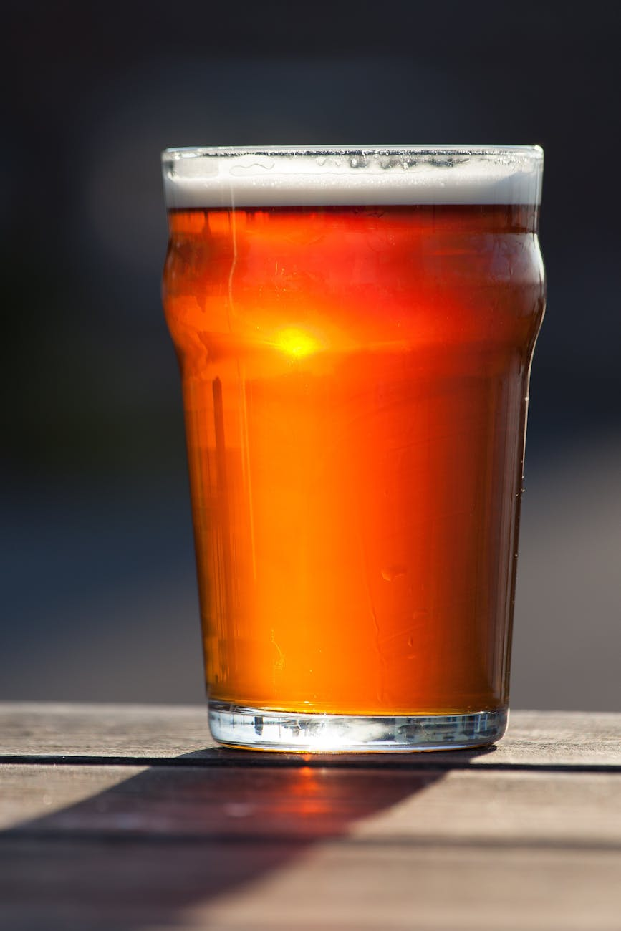
Pubs operate on thin margins – as operating costs increase, the price of a pint will rise
Most of the price of a pint goes to taxes and operating costs, leaving pubs with just a 2.5% margin.
The average price of a pint in 2024 is £4.80 – but pubs retain just £0.12 (2.5% margin).
Taxes account for 30% of the price, with VAT and duty making up the bulk. The rest covers costs such as ingredients, wages, utilities, and pub maintenance.
While the 1p duty cut on draught products and lower utility costs offer some relief, other government policies – including the reduction in business rate relief, higher NICs, NLW, and NMW, and the introduction of EPR – far outweigh this and will drive up costs in 2025.
As a result of both government policies and wider cost pressures, the price of a pint will need to rise by at least £0.21 this year just to maintain margins. Without an increase, pubs would lose £0.09 on every pint sold.
2024 price of a pint: £4.80
2024 Costs
2025 Costs
Tax £1.52
VAT £0.80
Duty £0.49
Business Rates £0.11
Employment Taxes £0.10
Corporation tax £0.02
Tax £1.58
VAT £0.80
Duty £0.48
Business Rates £0.11*
Employment Taxes £0.17**
Corporation tax £0.02
Other Costs £3.16
Cost of sales £1.24
Wages £0.91
Utilities £0.24
Other costs £0.77
Other Costs £3.31
Cost of sales £1.26
Wages £0.98
Utilities £0.22
Other costs £0.85
Income £0.12
Loss -£0.09
Source: Frontier analysis based on ONS data and BBPA price of a pint analysis (2024)
*Where pubs qualify for business rates relief with no cap this cost would be reduced by 8p in 2024 but only 3p in 2025 (due to reduced relief from 75% to 40%)
**Based on median annual gross pay in the Beverage Serving activities sector ONS (2024)

Slide 14
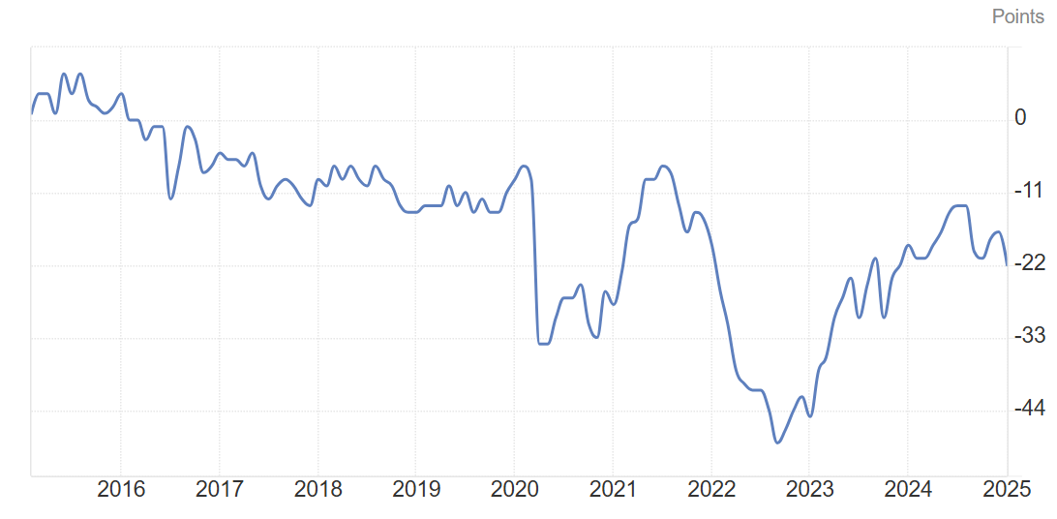
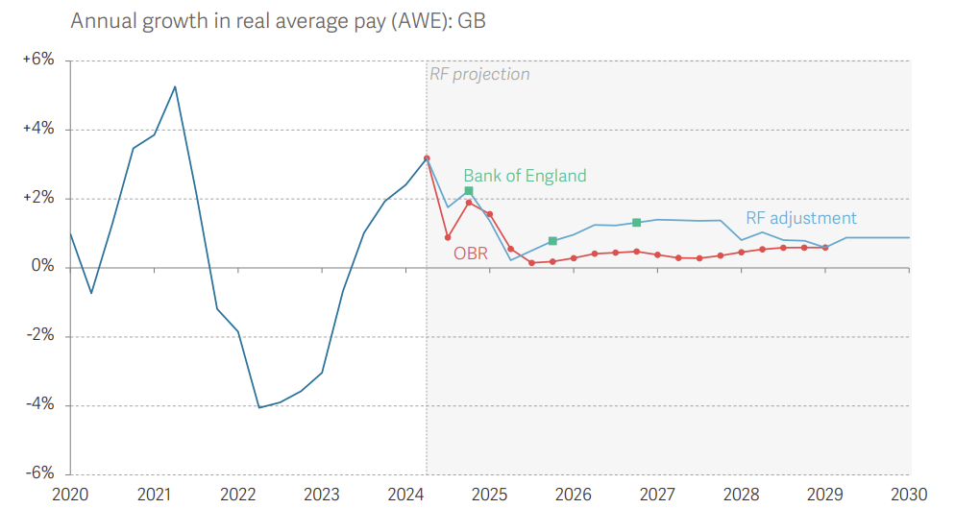
Pubs are particularly exposed to the consumer cost-of-living crisis and therefore concerned about the impact of further price increases on demand
Rising prices may put further pressure on pub demand
Consumer confidence remains low, though slightly improved since late 2023, meaning customers are still hesitant to spend. As finances tighten, consumers typically cut back on discretionary spending, and pubs have noticed a fall in:
The frequency of visits: For example, wet-led pubs are seeing regular customers cut back on 1 visit a week (~33% decrease) and some food-led pubs are noticing footfall fall, with customers choosing to go to restaurants when they do go out – 42% of consumers were going out less frequently than a year ago (CGA survey, January 2025).
The spend per visit: For example, wet-led pubs are mostly seeing individuals getting one less pint when visiting (~33% decrease) and some food-led pubs are noticing customers getting one less course during their meal – 17% of consumers said they will reduce the amount they spend on alcohol/drinks and 18% said the same for food (RSEM survey, January 2025).
Price sensitivity for beer, cider, and wine is growing, making customers more reactive to price changes (OBR 2024). This poses a risk as further price increases may exacerbate both reduced footfall and lower spending per visit.
Some pubs will be more exposed to spending cutbacks than others, depending on household pressures and pub proposition focus. For example, upmarket pubs may be more protected as their customers cut back less, and some wet-led pubs may experience more resilient demand than food-led pubs due to the relative cost of drinks versus meals.
While consumer confidence has improved since last year, it remains low…
…and limited real average pay growth expected over the next few years
Sources: The GfK Consumer Confidence indicator, Trading Economics; Resolution Foundation

Slide 15
Pubs and brewers of different sizes and business models will be impacted differently by changes to labour costs, packaging regulations, and business rates
This report is largely based on data and interviews with larger firms. These firms will have some knowledge of the impact on smaller firms which we are able to combine with self-reported impacts in surveys.
A January 2025 survey of 191 sector businesses found that smaller pubs and independents are significantly more pessimistic about both the market and their own prospects over the next 12 months - pessimism that has risen sharply over 2024.
Larger firms are more likely to have financial reserves to draw on, whereas smaller businesses and independents often lack a year’s cash reserves. They also face greater challenges navigating administrative burdens. For some, this has led to shifts in business planning – e.g. more leased and tenanted pubs are opting for temporary arrangements rather than long-term leases – which reduce investment.
Labour cost increases hit pubs particularly hard
Pubs face greater cost pressures than brewers due to their labour-intensive model. The NI threshold cut (£9,100 to £5,000) will push more part-time workers into contributions, disproportionately impacting pubs (60%+ part-time workforce).
NLW and NMW increases will raise wages directly and drive up pay across bands to maintain the differential.
NI rate increase will have a direct effect on costs for both pubs and brewers.
Food-led pubs, which have larger staff costs, will see the biggest cost increases.
Packaging regulations affect all brewers – especially medium, smaller brewers* and those reliant on glass
Changes to PRN and the new EPR regulations are adding additional costs for all brewers.
Low margins mean these costs must be passed on, but this is harder for smaller brewers with less bargaining power.
Beyond fees, the schemes bring administrative burdens, consuming a disproportionate amount of small businesses’ time.
Uncertainty around the charges and submission requirements adds complexity to cost modelling.
Glass bottles face the highest costs – many brewers are shifting to cans, though some are more reliant on glass.
Cuts to Business Rates Relief hits small pubs
Businesses can receive up to £110k in relief annually.
Smaller businesses below the threshold will feel the impact of a cut in the relief - facing a sharp rise in their tax bill (140%).
Where larger firms already exceed this cap and will continue to do so after the cut, won’t be affected by a reduction in Business Rates Relief
In a CGA Q4 2024 survey, 76% of operators expected lower profits, 54% anticipated job cuts, and 51% planned to cancel investments if relief were removed.
The cut, rather than full removal, means the impacts may be smaller but still impactful for operators.
Further uncertainty from expected increases in pub rateable values - dampening the effect of some proposed reforms
*Very small brewers are exempt

